Slide 1

Inside Information
Zoidberg
Amir Arad – Data Engineer

Slide 2
Agoda Data Challenges
Working with huge amounts of data
Various sources (HDFS, Partners, Vertica, MsSQL)
Heavy computations (L-bfgs)
Complicated logic – compound models, Incorporating Business logic with ML prediction
Continuous Testing

Slide 3
Where big data lives
Hadoop
HDFS
Powerful Clusters (~40TB memory, 6000 cores)
Bringing the code to the Data
Resource Management

Slide 4
Spark
Amazing massive parallelization
Mostly in memory

Slide 5
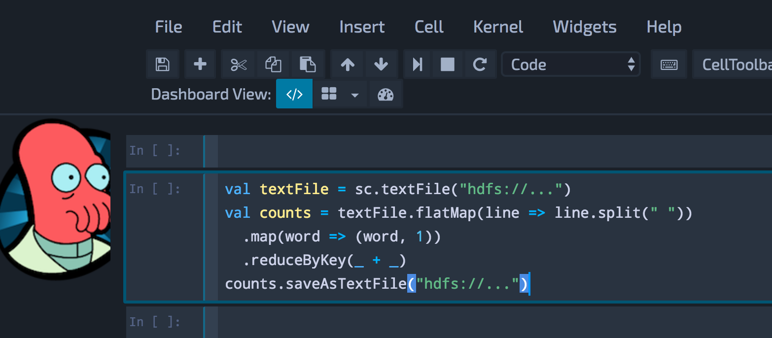
Spark
Small code base
Big community
Easy to develop

Slide 6

Spark Deploy Modes
Cluster / Client

Slide 7
Development Cycle
Before Zoidberg
Devs / Researchers working on their IDE + SQL IDE
Writing new model, pipeline or data transformation
Testing Locally with a Hadoop cluster running on Vagrant
Deploying spark application to the cluster
Wait For Results, inspect output data + logs
Repeat

Slide 8
Ready Made Solutions
Interactive spark
Zeppelin
Spark-Notebook
Jupyter + Toree
Data bricks

Slide 9


Requirements
Here Comes Zoidberg
Easy To Use
Notebook Based
Isolated Spark Apps
Simulate “deployed” app
Visualizations

Slide 10
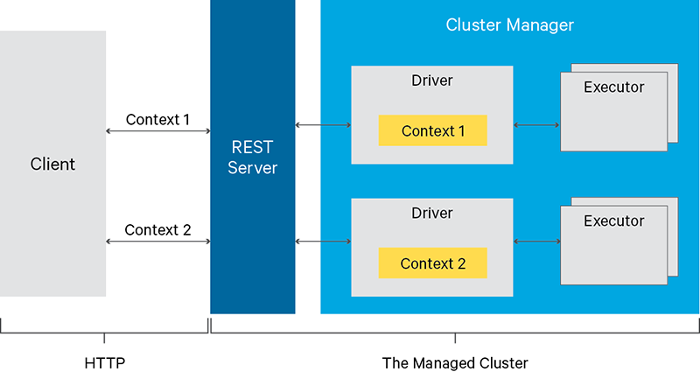
Livy

Slide 11
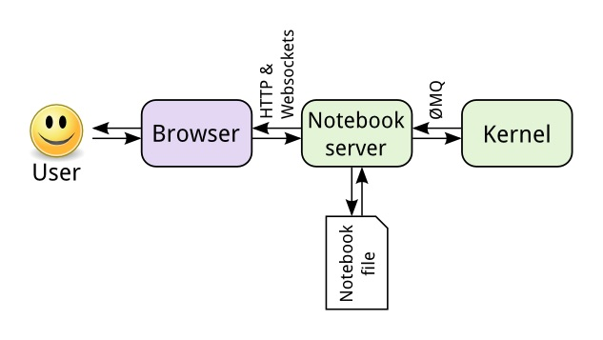
JupYter
Web based Notebook engine
Interactive
Sharable

Slide 12
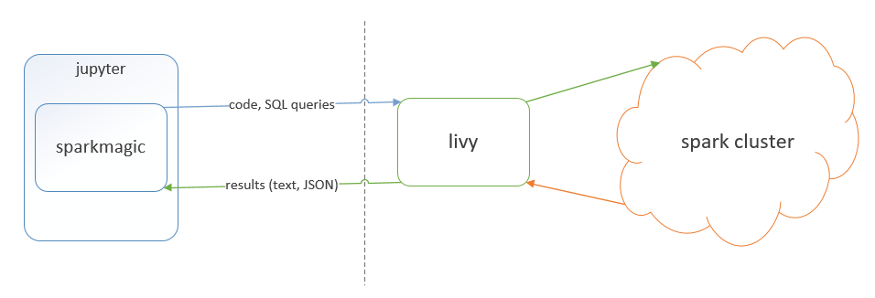
SparkMagic

Slide 13
zoidberg deploy
Packaging , Uploading & adding to classPath
Take Configs
Upsert Notebook

Slide 14
Zoidberg Usages
aftermath
Scala (+ SQL) REPL running on the Cluster
Debugging
Quick research
Multi language run time (Python, R)
Dashboards (really cool Visualizations)

Slide 15
Extras added with time
Zoidberg Evolves
Two parallel Setups - Spark 1.5 & Spark 2
Auto-Zoidberg -> scheduler for running notebooks
Easier HTML rendering from Scala
Backups

Slide 16
Other Projects
Zaphod – Running ML application on our GPU Cluster
Combines the Massiveness of our Hadoop cluster with the computational powers of GPU
Easy & seamless integration between the clusters
Running non-scala code (mainly TensorFlow) within a scala-spark application
Manages Docker containers on GPU machines

